Slide 1
Viruses vs. Bacteria

Slide 2
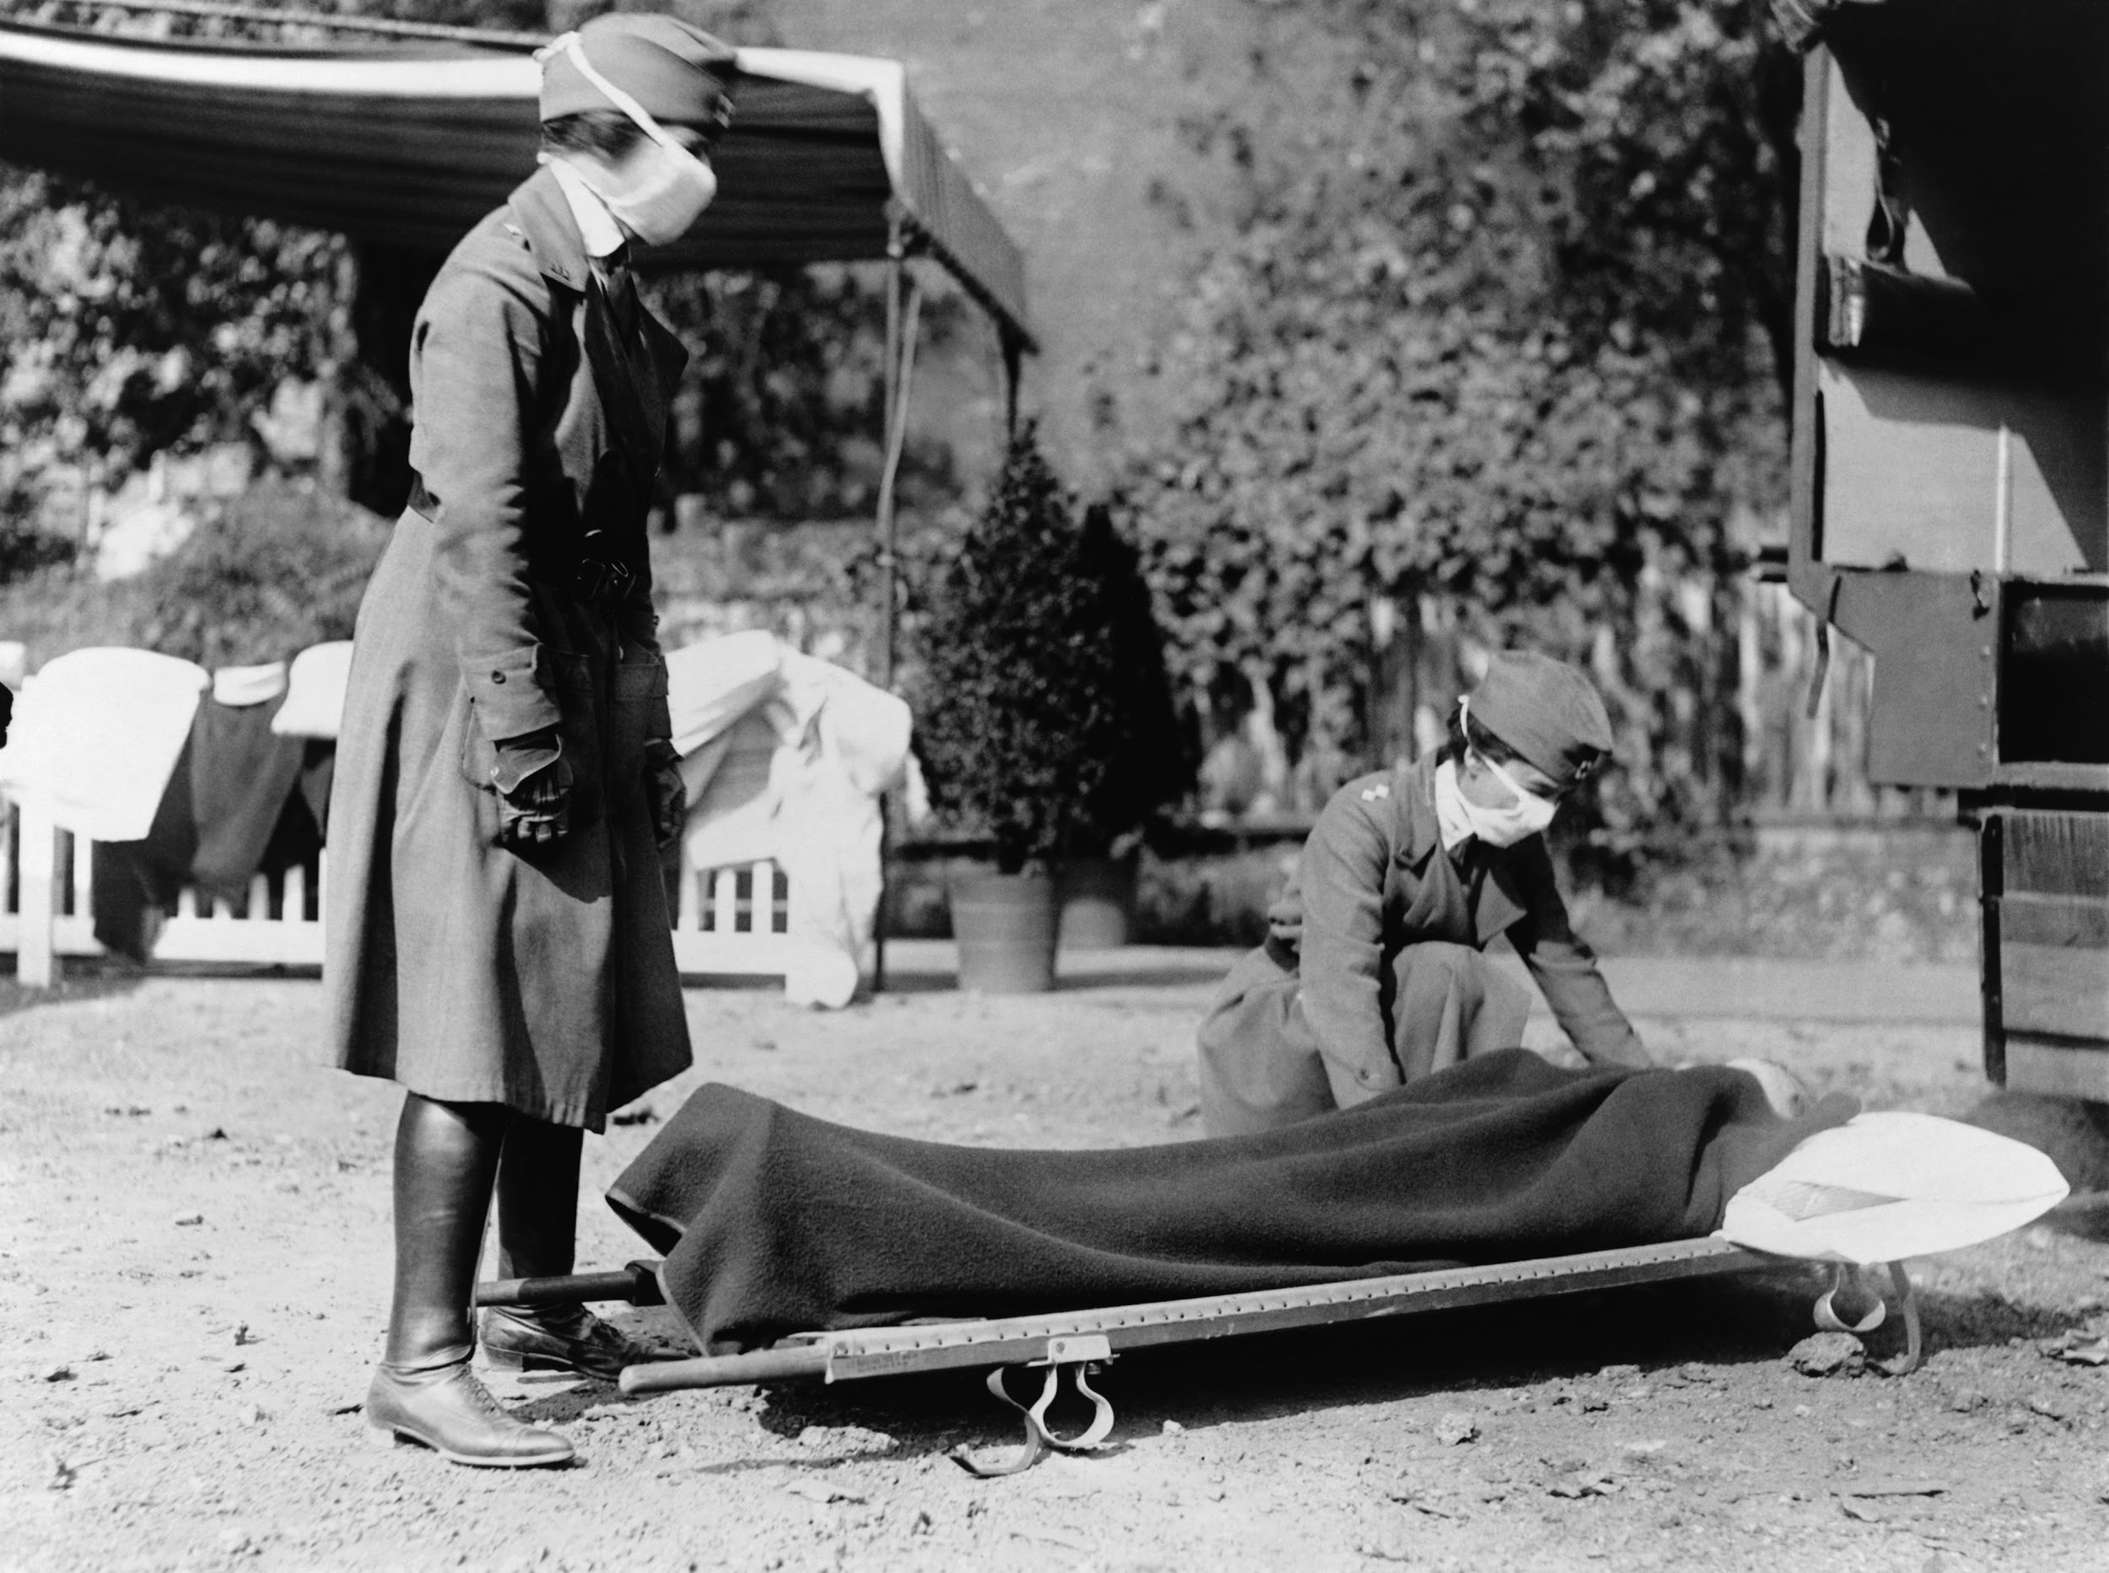
Viruses
The influenza pandemic of 1918-1919 killed more people than World War I, at somewhere between 20 and 40 million people.
More people died of influenza in a single year than in four-years of the Black Death (1347).
Viruses are pathogens that attack cells from the inside. They hijack your own DNA and use it against you. A virus cannot be treated with antibiotics, it can only run its course until your immune system kicks it out.

Slide 3
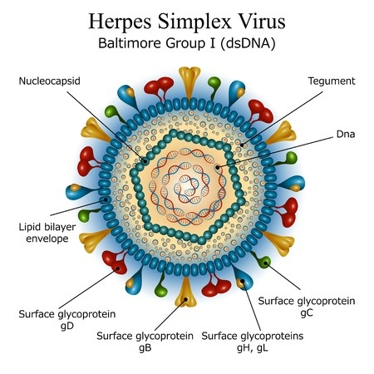
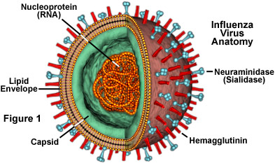
Properties of viruses
no membranes, cytoplasm, ribosomes, or other cell parts
cannot move or grow
can only reproduce inside a host cell
consist of 2 major parts - a protein coat, and hereditary material (DNA or RNA)
are extremely tiny, only visible with electron microscopes

Slide 4
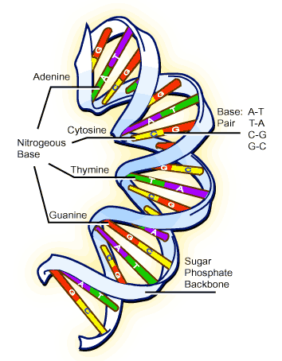
Structure of DNA (review)
Shape of a DOUBLE HELIX
Each side held together by weak HYDROGEN BONDS
Repeating units of NUCLEOTIDES
Sides of "ladder" are deoxyribose and phosphates
Center is A, T, G, C
A -> T
G -> C *base pair rule

Slide 5
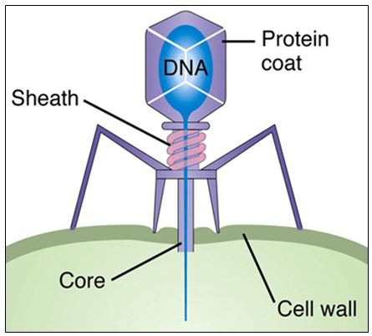
Virus Structure
Virus has a covering that has a capsid and sometimes an envelope
Inner core contains a nucleic acid molecule (DNA or RNA) and various proteins
Viruses are usually very specific to their host and to the cells they can infect.
This is a bacteriophage, a type of virus that attacks bacteria. It is recognizable because it looks like the lunar landing spaceship.
See animation http://www.youtube.com/watch?v=41aqxcxsX2w&feature=related

Slide 6
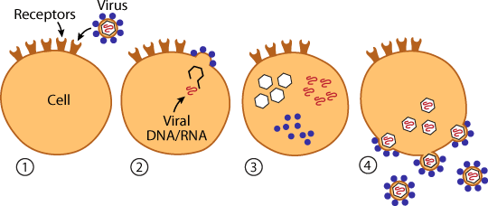
1. Attachment
2. Penetration - the virus is engulfed by the cell (Cell can enter Lysogenic or Lytic Cycle)
3. Biosynthesis - viral components are made (protein coat, capsid, DNA/RNA)
4. Maturation - assembly of viral components
& Release - viruses leave host cell to infect new cells

Slide 7
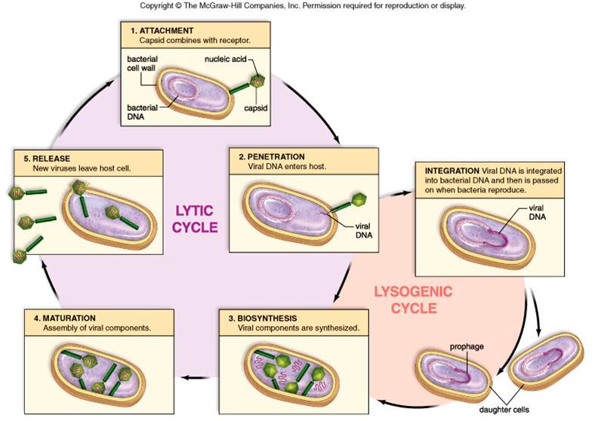
Viral Reproduction Lytic cycle = reproduction occurs, cells burst Lysogenic cycle = reproduction does not immediately occur (dormancy)

Slide 9
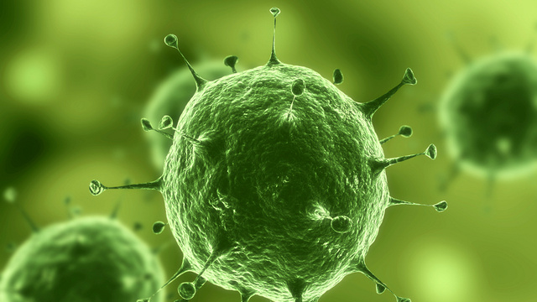
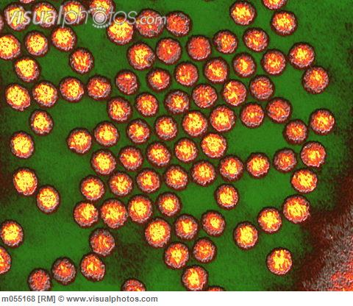
Types of Viruses
Bacteriophages - infect bacteria
Retroviruses - have RNA instead of DNA
Check out this Gallery at Virusworld

Slide 10
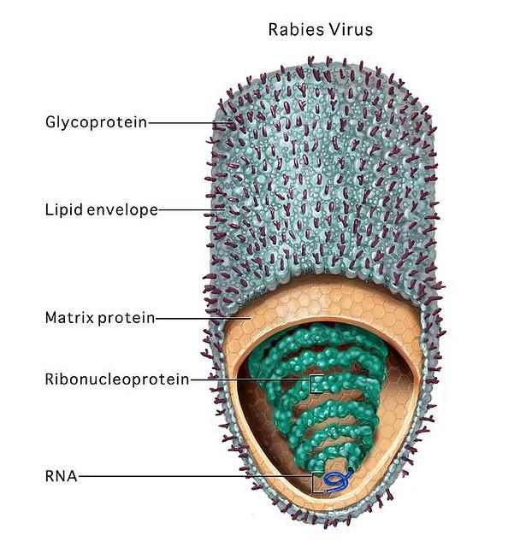
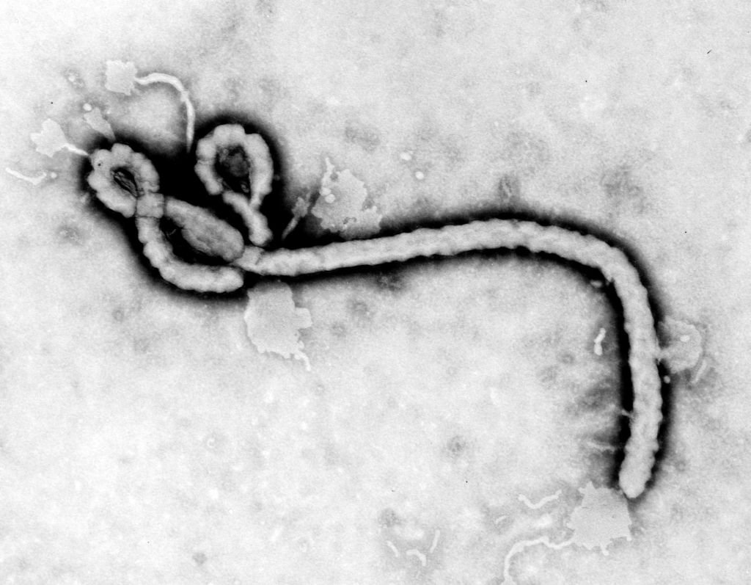
Viruses may be named according to
the associated diseases (poliovirus, rabies)
the type of disease caused (murine leukemia virus)
the sites in the body affected or from which the virus was first isolated (rhinovirus, adenovirus)
where they were first isolated (Ebola virus, Hantavirus),
the animal that carries the virus (bird flu, swine flu)
for the way people imagined they were contracted (dengue = ‘evil spirit’; influenza = ‘influence’ of bad air).

Slide 11
Monerans
Nucleus
Unicellular without a ______________
Microorganisms:
Structure:
Reproduce asexually (binary fission) Mitosis
Organisms that can not be seen without a microscope
Capsule
Cytoplasm
DNA
Cell Membrane

Slide 12
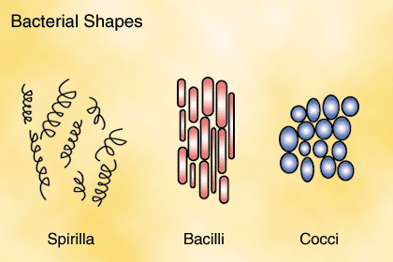
Monerans
Classified into three types by shape
Cocci bacteria - ________________
Bacilli bacteria - _____________
Spirilla bacteria - ______________
Spherical (Round)
Rod
Spiral (Spring)

Slide 13
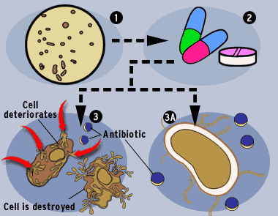
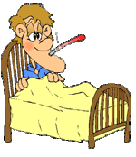
Monerans
disease
Harmful bacteria cause__________ and food spoilage
Destroyed by_____________
Antibiotics

Slide 14
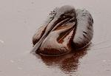
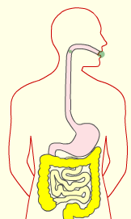
Monerans
Clean-up (oil spills)
Helpful Bacteria are used in environmental ________________, digestion of food, and production of antibiotics(______________________)
and ______________
Substance that can destroy bacteria only
food production

Slide 15
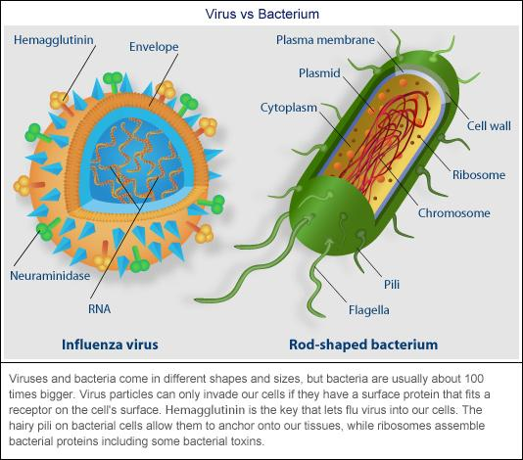
Actual Size

