Slide 1
The Physics of Everyday Life: Sailing “How can a sailboat sail into the wind?”
By Michelle Cooper
Physics 30
January 22, 2016
Ms. Warnock

Slide 2
A sail boat is a vessel that uses wind power to move across bodies of water.

Slide 3
Aerodynamics 101
Bernoulli's principle:
states that for an inviscid flow of a non-conducting fluid, an increase in the speed of the fluid occurs simultaneously with a decrease in pressure or a decrease in the fluid's potential energy.

Slide 4
The Principals of Sailing Upwind
The Bernoulli's Principal
And
The effect of the Keel

Slide 5
Sailing Directly Upwind (Bernoulli’s Principal)

Slide 6
Sailing Directly Upwind (Bernoulli’s Principal + Keel)

Slide 7
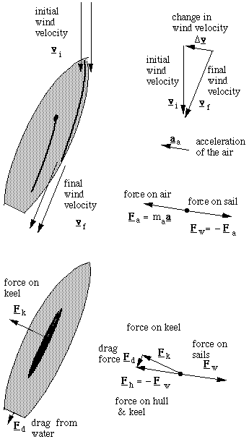
Formulas
v_{i} =Initial Velocity
v_{f} = Final Velocity
Δv = Change of Velocity
Acceleration of the air is a_{a} = Δv/Δt
F_{a} = Force that sails exert on the air
F = ma Newton's second law
F_{w} = Force that the wind exerts on the sails
F_{k} = Force on the keel
F_{d} = Drag force
F_{w} = -{F_{k} + F_{d}}

Slide 8
“How can a sailboat sail into the wind?”
sailing into the wind is possible when the sail is at an angle of at least 45 degrees to the oncoming wind causing the wind to change direction. The boat will move forward because the keel, of the boat acts to the water as the sail acts to the wind. The force on the sail is opposed by the force on the keel.

Slide 9
Thank You
freaking

Slide 10
http://physicsbuzz.physicscentral.com/2015/05/the-physics-of-sailing-how-does.html
http://www.maztravel.com/articles/sailing.html
http://www.physicsforarchitects.com/Sailing_against_the_wind.php
http://ffden-2.phys.uaf.edu/211_fall2002.web.dir/josh_palmer/basic.html
http://www.real-world-physics-problems.com/physics-of-sailing.html
http://www.sailingteam.tuc.gr/TUC_Sailing_Team/INTERESTING/Entries/2010/12/18_Physics_of_Sailing_files/PTO000038.pdf
Bibliography

