Slide 1
Taxonomy
Classifying organism

Slide 2
Taxonomy
Taxonomy is a field of biology that deals with classifying organisms
The classification biologist use show the evolutionary relationship of the organisms
Modern taxonomy uses a binomial nomenclature, which is two scientific names for every organism.
Example: Homo sapiens
The first name is the genus name and is always capitalize
The second name is the species all in lowercased letters
The name should be underline or in italics

Slide 3
Why Does Science have weird names
Why can’t we just call a Drosophila melanogaster a fruit fly. Well if you were to travel to China or Germany to complete research on the Drosophila melanogaster, but called it a fruit fly, your fellow researchers would have no idea what you are talking about.
The binomial nomenclature is Universal!

Slide 4
Scientific names can be abbreviated by using the capital letter of the genus and a period: Example. P. leo (lion)
Members of the same genus are closely related. Only members of the same species can interbreed (under natural conditions) Some hybrids do occur under unnatural conditions: ligers are crosses between tigers and lions.

Slide 5
Hierarchy of Classification
Carolus Linnaeus came up with a ranking system for organisms.
Kingdom
Phylum/Division
Class
Order
Family
Genus
Species
King
Philip
Came
Over
For
Good
Soup

Slide 6
 | Human | Cougar | Tiger | Pintail duck
Kingdom | Animalia | Animalia | Animalia | Animalia
Phylum/Division | Chordata | Chordata | Chordata | Chordata
Class | Mammalia | Mammalia | Mammalia | Aves
Order | Primate | Carnivora | Carnivora | Anseriformes
Family | Homindae | Felidae | Felidae | Anatidae
Genus | Homo | Felis | Panthera | Anas
Species | sapiens | concolor | tigris | acuta

Slide 7
Modern Evolutionary Classification
Linnaeus grouped species mainly on visible similarities & differences
Today, taxonomists group organisms into categories that represent lines of evolutionary descent (phylogeny)
Evolutionary relationships among a group of organisms can be shown on a cladogram
Similarities in DNA and RNA

Slide 8
DNA & RNA is similar across all life forms
Genes of many organisms show important similarities at the molecular level
DNA shows evolutionary relationships & helps classify organisms

Slide 9
The Six Kingdoms
Kingdom | number of Cells | energy | cell type | examples
archaebacteria | unicellular | some autotrophic, most chemotrophic | prokaryote | "extremophiles"
eubacteria | unicellular | autotrophic and heterotrophic | prokaryote | bacteria, E. coli
fungae | most multicellular | heterotrophic | eukaryote | mushrooms, yeast
plantae | multicellular | autotrophic | eukaryote | trees, grass
animalia | multicellular | heterotrophic | eukaryote | humans, insects, worms
protista | most unicellular | heterotrophic or autotrophic | eukaryote | ameba, paramecium, algae

Slide 10
Dichotomous key
Dichotomous key is a tool used for identifying unfamiliar organisms
A dichotomous key is a written set of choices that leads to the name of an organism

Slide 11
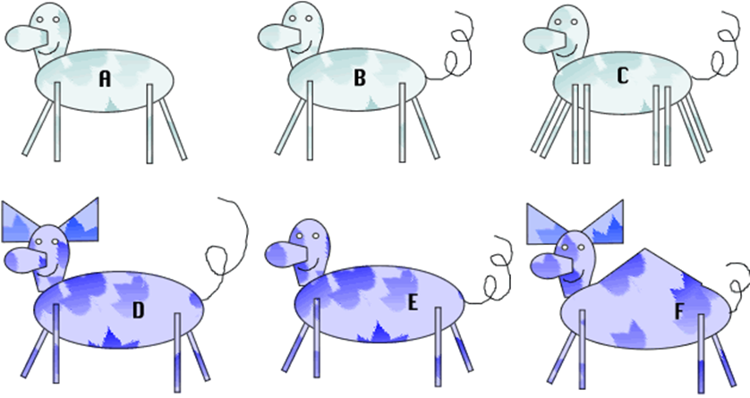
Consider the following animals. They are all related, but each is a separate species. Use the dichotomous key below to determine the species of each.
1. | Has grayish blue colored body ......go to 2
 | Has purple colored body ..... go to 4
2. | Has 4 legs .....go to 3
 | Has 8 legs .......... Deerus octagis
3. | Has a tail ........ Deerus pestis
 | Does not have a tail ..... Deerus magnus
4. | Has a pointy hump ...... Deerus humpis
 | Does not have a pointy hump.....go to 5
5. | Has ears .........Deerus purplinis
 | Does not have ears ......Deerus deafus

