Slide 1
Kingdom Protista

Slide 2
Characteristics of Protists
mostly unicellular, some are multicellular (algae)
can be heterotrophic or autotrophic
most live in water (though some live in moist soil or even the human body)
ALL are eukaryotic (have a nucleus)
A protist is any organism that is not a plant, animal or fungus
Protista = the very first

Slide 3
Classification
Protists are classified by:
How they obtain nutrition
How they move
Animallike Protists – also called protozoa (means “first animal”) heterotrophs
Plantlike Protists – also called algae – autotrophs
Funguslike Protists – heterotrophs, decomposers, external digestion

Slide 4
Animal-Like Protists: Protozoans
There are Four Phyla of Animal-like Protists – Classify Protists by how they move
Zooflagellates – flagella
Sarcodines – extensions of cytoplasm (pseudopodia)
Ciliates – cilia
Sporozoans – do not move

Slide 5
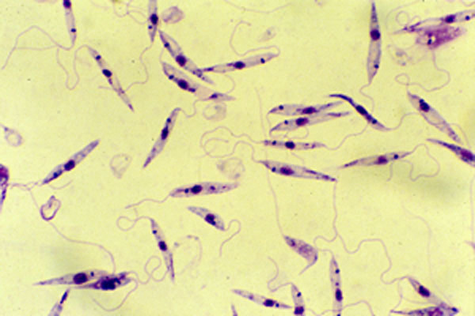
Zooflagellates
Move using one or two flagella
Absorb food across a membrane
Ex. Leishmania

Slide 6
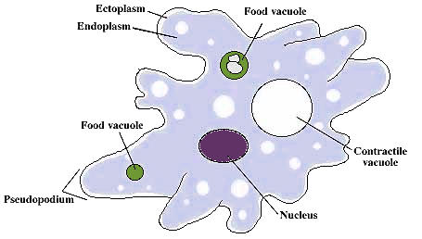
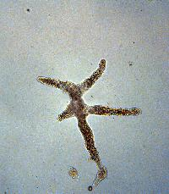
Sarcodines
moves using pseudopodia (“false feet”), which are like extensions of the cytoplasm — ameboid movement
ingests food by surrounding and engulfing food (endocytosis), creating a food vacuole
reproducing by binary fission (mitosis)
contractile vacuole – removes excess watercan cause amebic dysentery in humans – diarrhea and stomach upset from drinking contaminated water
Other sarcodines: Foraminferans, Heliozoans

Slide 7
Ameba Proteus

Slide 8
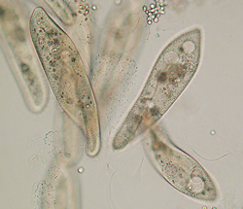
Ciliates
move using cilia
has two nuclei: macronucleus, micronucleus
food is gathered through the :mouth pore, moved into a gullet, forms a food vacuole
anal pore is used for removing waste contractile vacuole removes excess water
exhibits avoidance behavior
reproduces asexually (binary fission) or sexually (conjugation)
outer membrane -pellicle- is rigid and paramecia are always the same shape, like a shoe

Slide 9
Sporozoans
do not move on their own
parasitic
Malaria is caused by a sporozoan (Plasmodium), which infects the liver and blood; transmitted by mosquitos

Slide 10
Plant-Like Protists
Plant-Like Protists

Slide 11
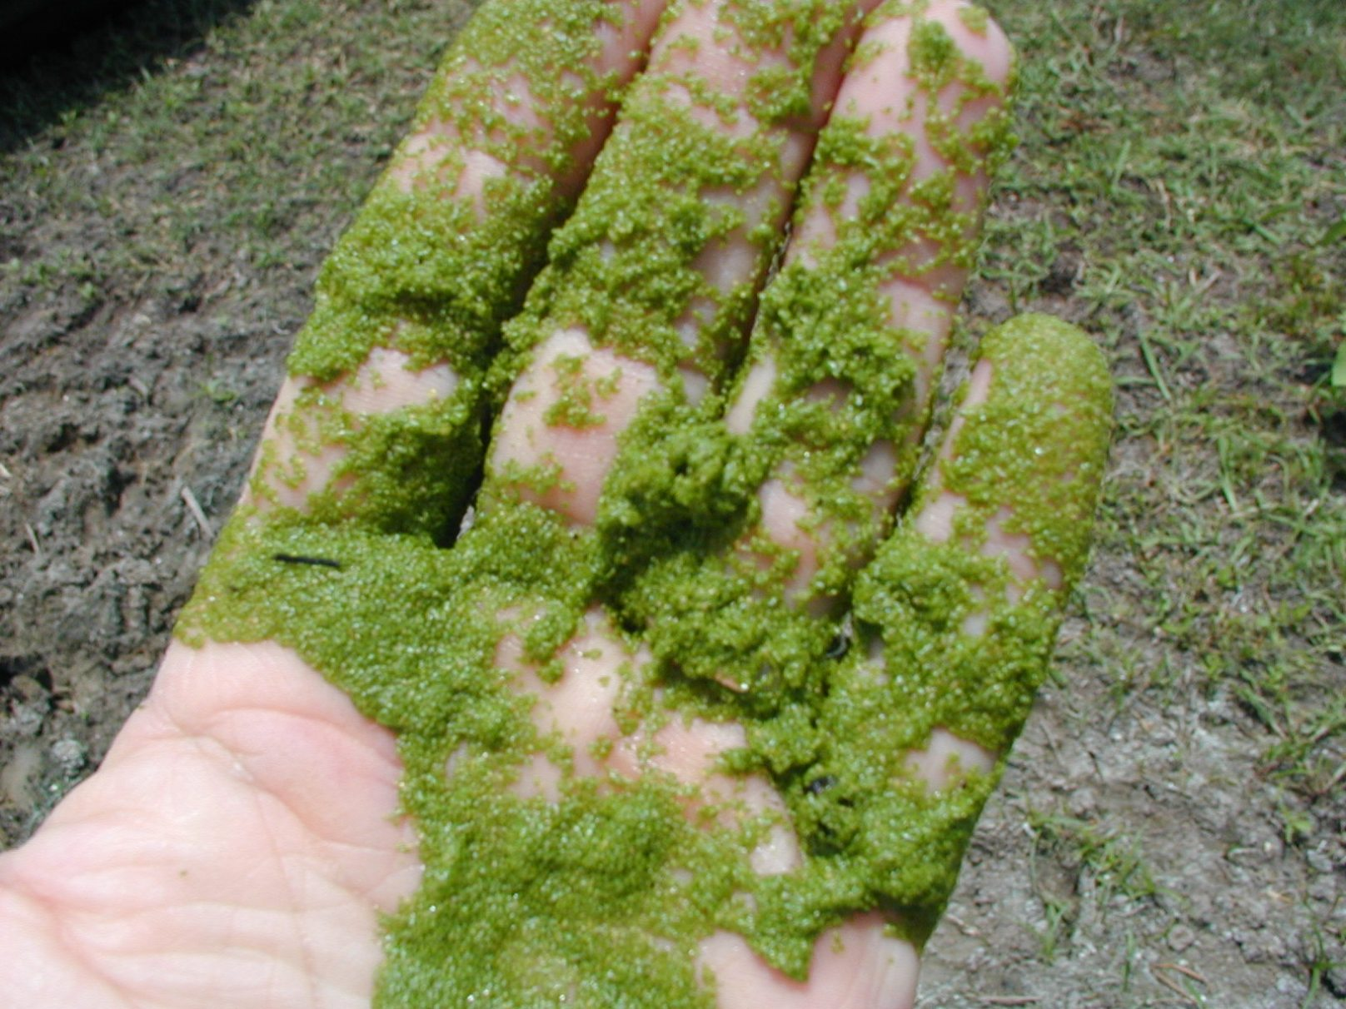
Characteristics
- carry out photosynthesis
- can be unicellular or multicellular
- commonly called algae

Slide 12
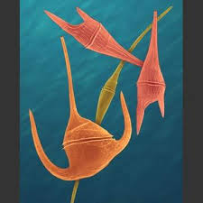
Some have pigments, which give algae a variety of colors
Pictured: Dinoflagellates

Slide 13
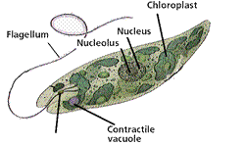
Euglena
live in water
have 2 flagella for movement
use chloroplasts for photosynthesis, but can turn into heterotrophs

Slide 14
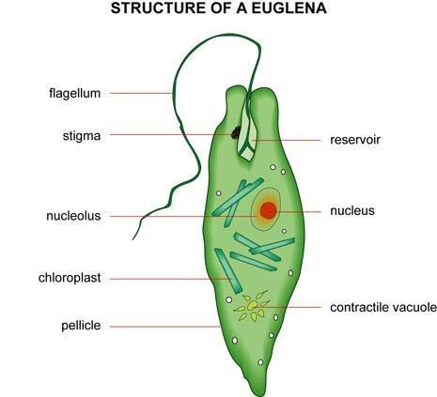
has an eyespot used for sensing light and dark
pellicle - like a cell wall, helps maintain their shapes

Slide 15
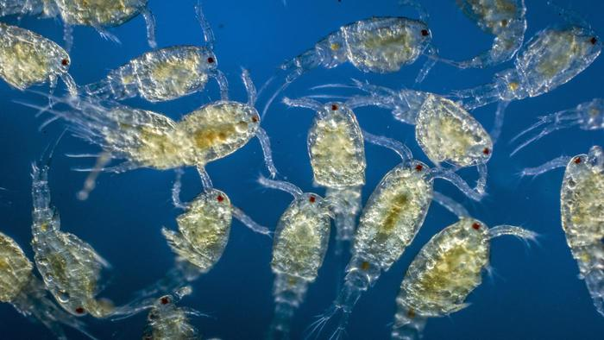
Ecology of Unicellular Algae
make up the base of aquatic food chains
plankton makes up half of the photosynthesis that occurs on earth (oxygen)

Slide 16
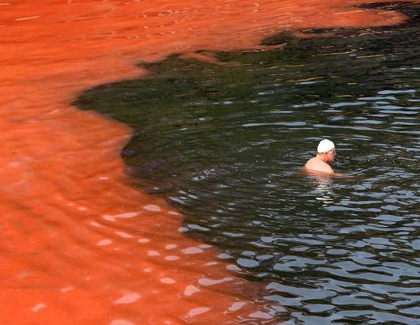
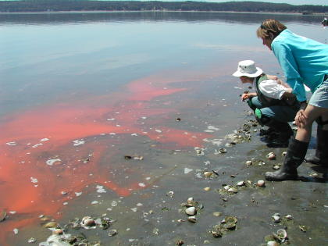
Red Tides - algal blooms , toxic

Slide 17
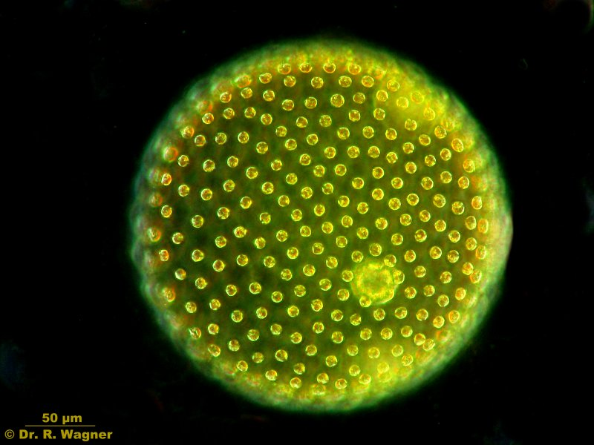
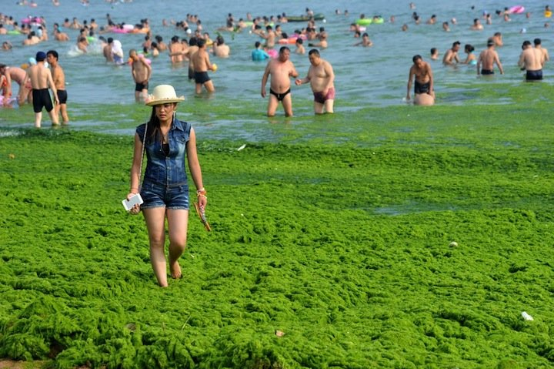
Green Algae:
Unicellular green algae, Colonial (volvox), Multicellular (ulva, sea lettuce)

Slide 18
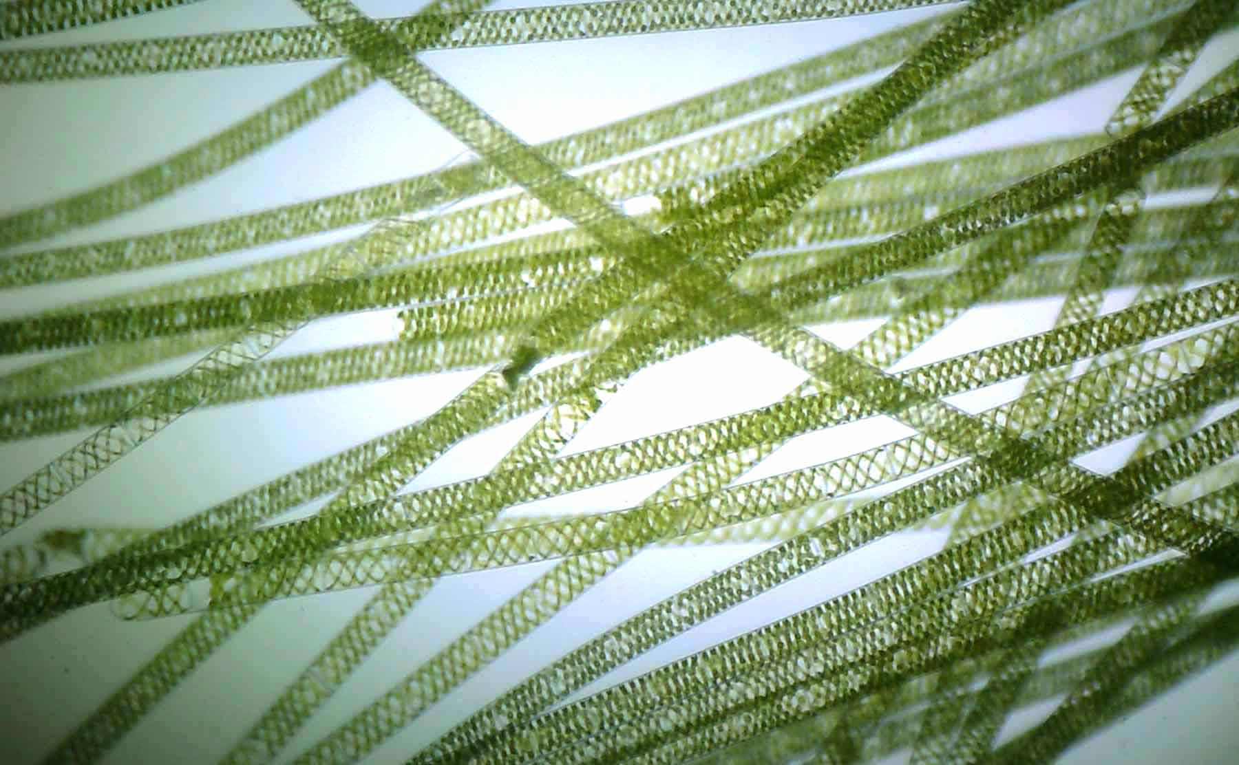
Spirogyra
-multicellular
- Have spiral shaped chloroplasts

Slide 19
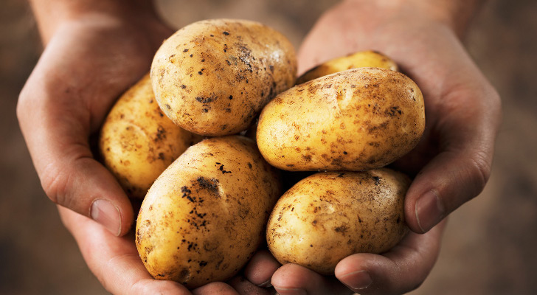
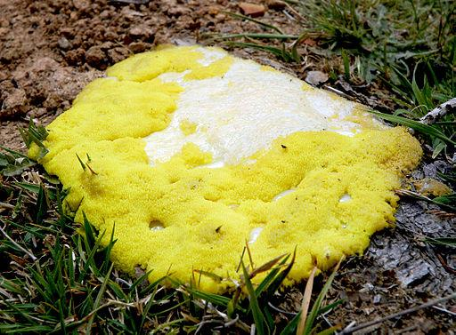
Funguslike Protists
heterotrophs, decomposers
called slime molds and water molds
Btw…water molds caused the IrishPotato Famine

