Slide 1
THE PHYSICS OF BILLIARDS
By Nicole Thompson

Slide 2
What is Billiards?
Billiards (pool) is a game based on physics. There are three main types of physics in a game of pool. There is the collision of the balls, the sweet spot, and relative slipping. Each of these things have a part to play in the making of the perfect pool shot.

Slide 3
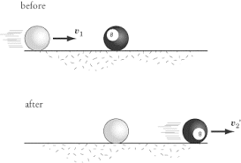
Ball Collisions
When the cue ball hits another ball
all of its energy is transferred so the
cue ball stops moving and the other ball
continues in the cue ball’s path of motion.

Slide 4
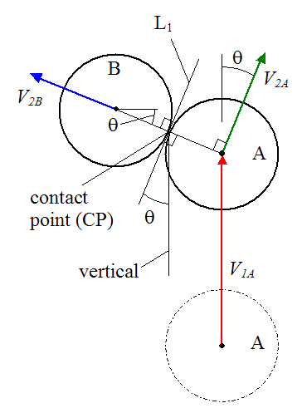
Ball Collisions (continued)
.
When balls collide it is an elastic-collision and the momentum is continued.

Slide 5
Formulas
.

Slide 6
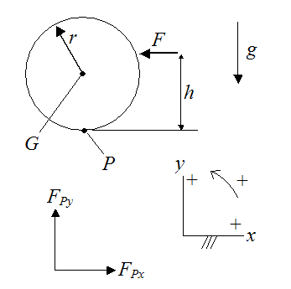
The Sweet Spot
The sweet spot is the spot on the ball that allows the ball to travel with no force of friction. Once the location of the sweet spot is known it allows you to put top/back spin on the ball or to curve the ball. This is a picture of
a free body diagram.

Slide 7
How to find the Sweet Spot

Slide 8
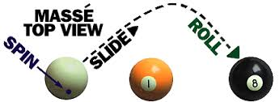
Relative Slipping
Relative slipping is how much of a spin the ball has. Trick shots are mostly relative slipping.
https://www.youtube.com/watch?v=JszLYsU1Duo

Slide 9
Conclusion
While making this presentation I was thoroughly surprised at how many different aspects of physics were involved in playing pool. I learned how to make the perfect shot (although I probably still can’t do it properly because I am a terrible pool player) and I learned how to make the ball move to your advantage. I learned how much physics affects the little things in life.

Slide 10
Bibliography
http://www.real-world-physics-problems.com/physics-of-billiards.html
http://archive.ncsa.illinois.edu/Classes/MATH198/townsend/math.html
http://billiards.colostate.edu/physics/Alciatore_SCIAM_article_posted_version.pdf
http://www.billiardworld.com/physics.html
http://www.trickshottim.com/learn/pool-physics/

Slide 11
Enjoy Playing Billiards! :)

