Slide 1
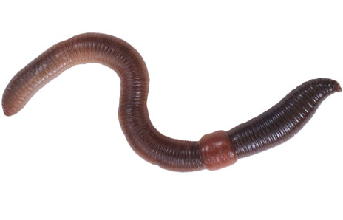
Phylum Annelida
(segmented worms)

Slide 2
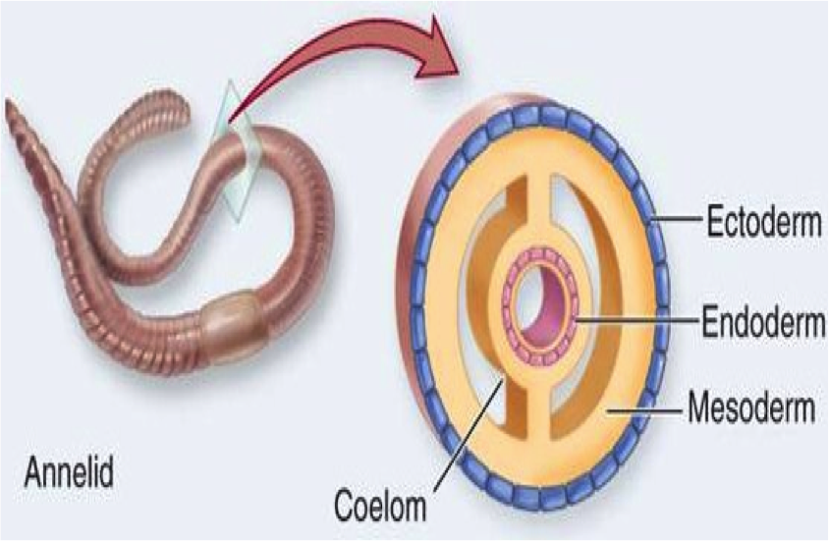
Main Characteristics
segments true coelom (body cavity)

Slide 3
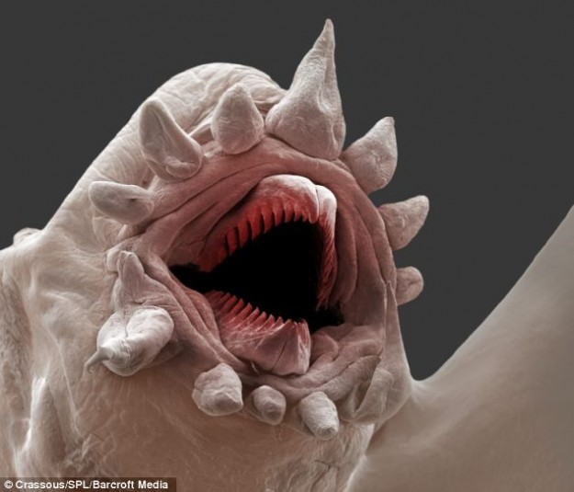
Annelids
Include:
earthworms
marine worms
leeches
This is a scale worm (Polychaetes). They live 1000 meters below the water’s surface and can turn their mouths inside out.

Slide 4
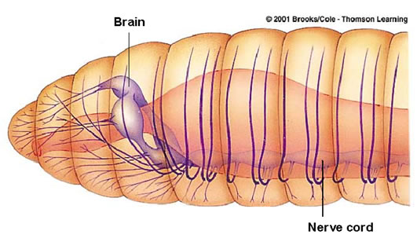
Other Traits
- Annelida means “little rings”
- body segments separated by septum
** Septum = internal wall

Slide 5
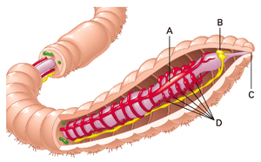
-some have bristles called setae
-have closed circulatory system
-have well-developed nervous system (brain)

Slide 6
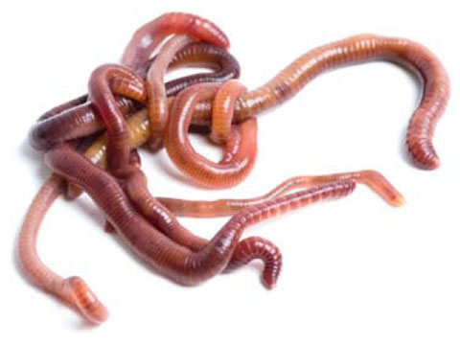
- sexual reproduction in annelids
- some are hermaphrodites

Slide 7
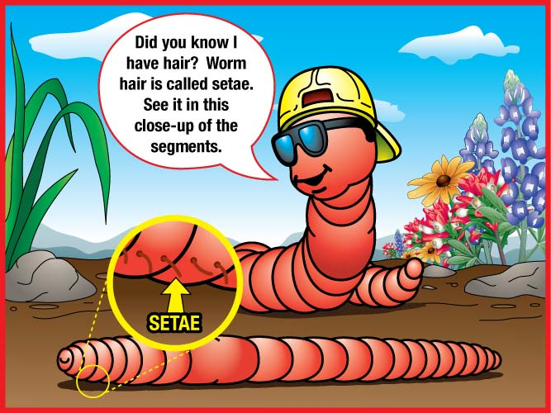
Class Oligochaeta – Earthworm
-Few setae
-Live in soil or fresh water
-Castings - enrich soil, (worm poop)

Slide 8
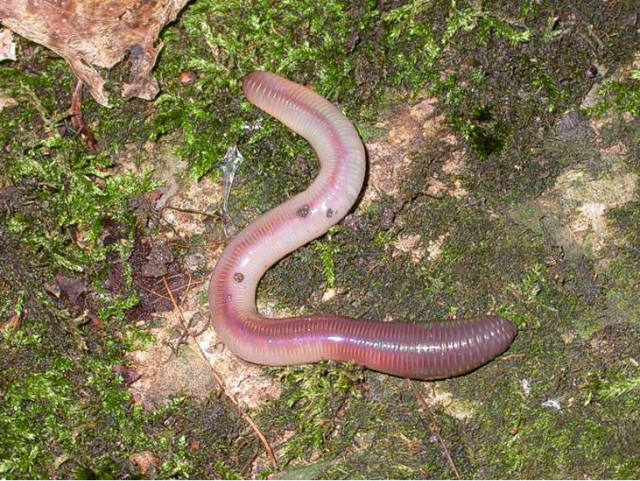

Slide 9
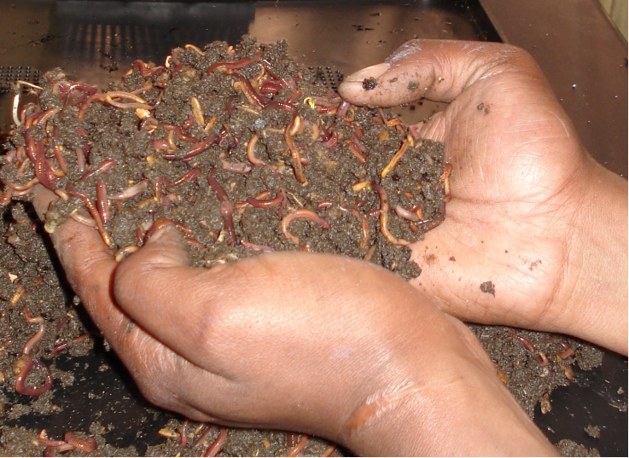

Slide 10
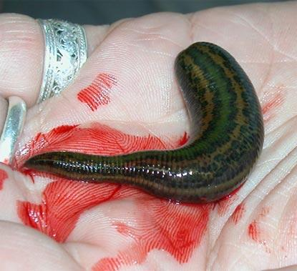
Class Hirudinea
-Leeches
-external parasites with suckers on each end
-medicinal uses (circulation, anti-clotting)

Slide 11
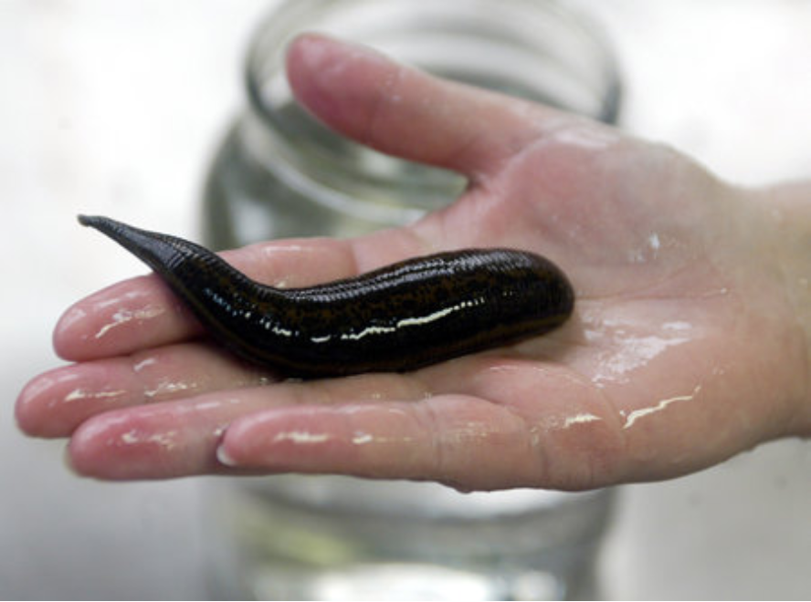

Slide 12
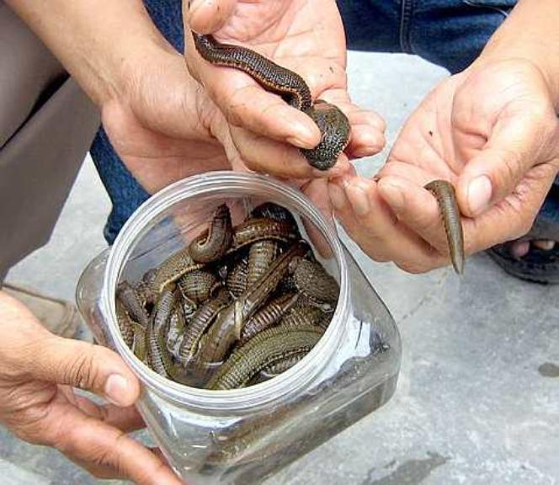
Leeches being bred for medical uses.

Slide 13
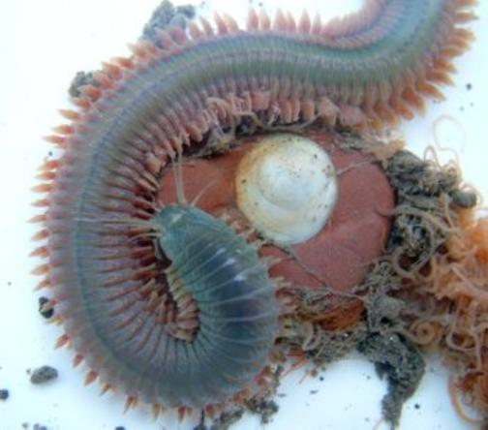
Class Polychaeta
Marine worms
-includes: sandworms, bloodworms, fireworms
-have paddle-like appendages with setae

Slide 14
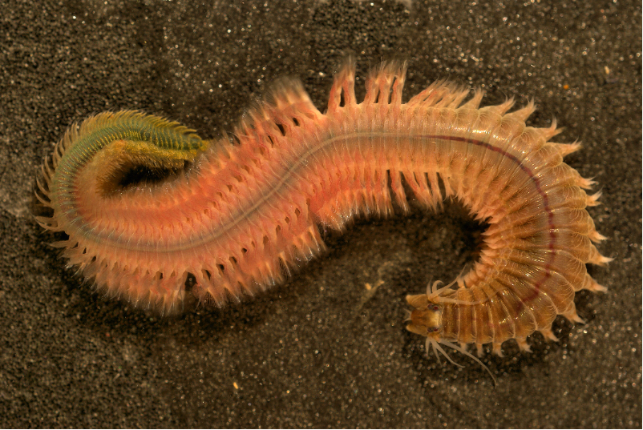
Nereis

Slide 15
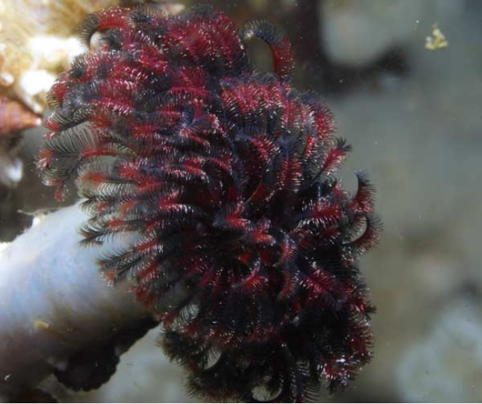
Featherduster

Slide 16
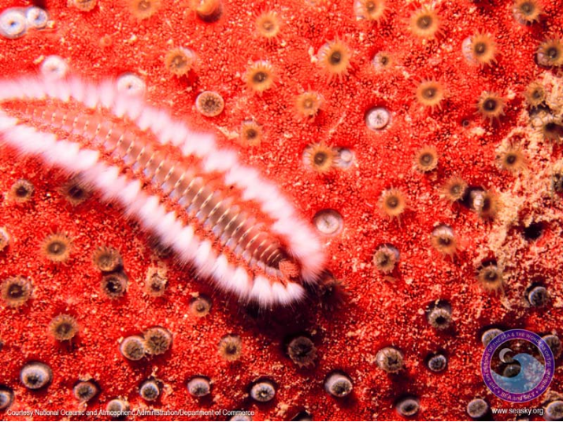
Fireworm

Slide 18
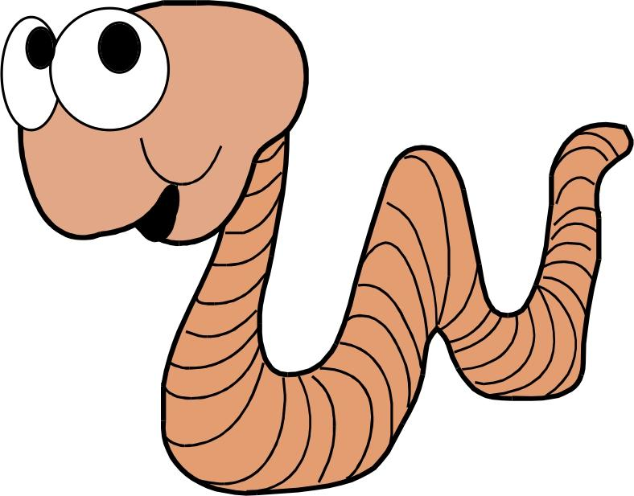
Recap: Taxonomy
Kingdom Animalia
Phylum Annelida
Class Oligochaeta (earthworms)
Class Hirudinea (leeches)
Class Polychaeta (marine worms)
*All are segmented, and have a coelom

Slide 19
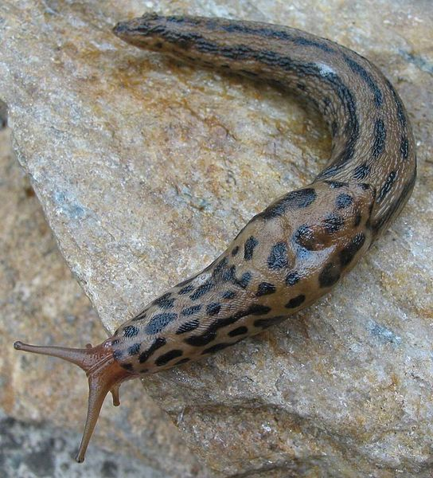
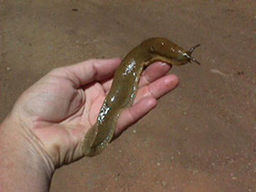
Mollusks
Kingdom Animalia, Phylum Mollusca (means “soft”)

Slide 20
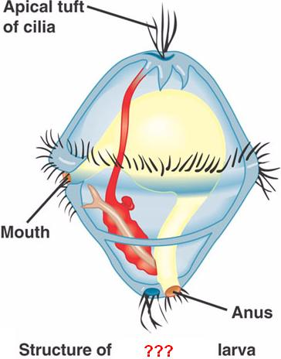
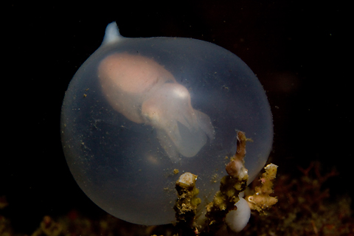
What is a Mollusk?
Soft body with internal or external shell
Ex: snails, slugs, clams, squids, and octopi
Trochophore larva

Slide 21
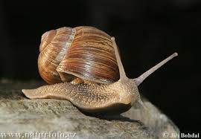
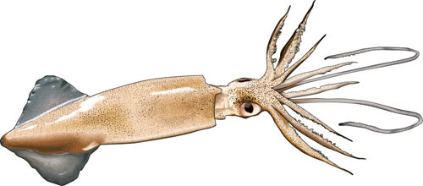
Body plan:
Visceral mass – internal organs
Mantle – covers the body
Foot – takes on many forms
Shell – (present in most)

Slide 22
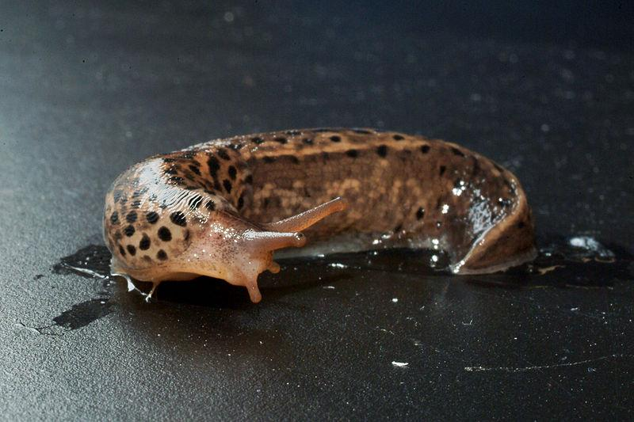
Groups of Mollusks
Three major classes of mollusks
Gastropods
Bivalves
Cephalopods

Slide 23
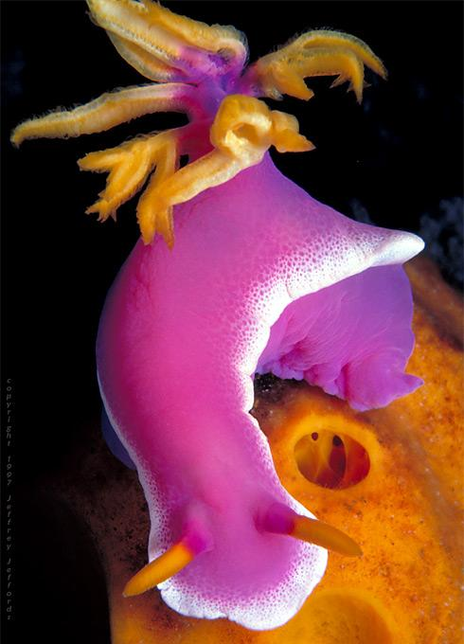
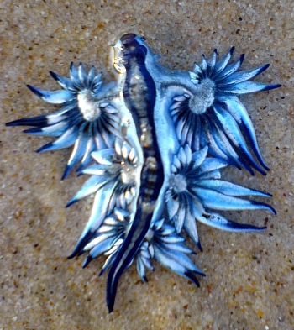
Gastropod
snails, slugs, and nudibranchs
Shell-less or single shelled
Move by a muscular foot
Some are poisonous, bright colors

Slide 24
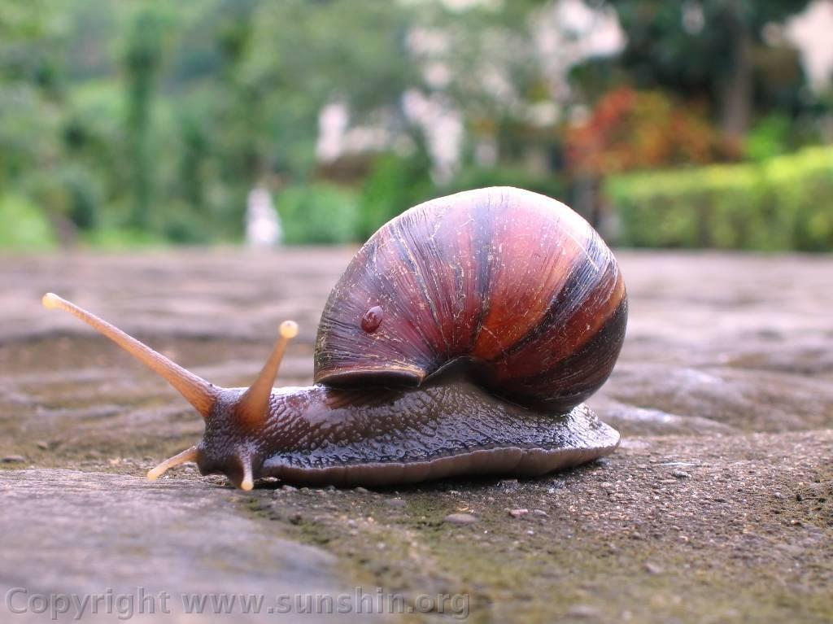
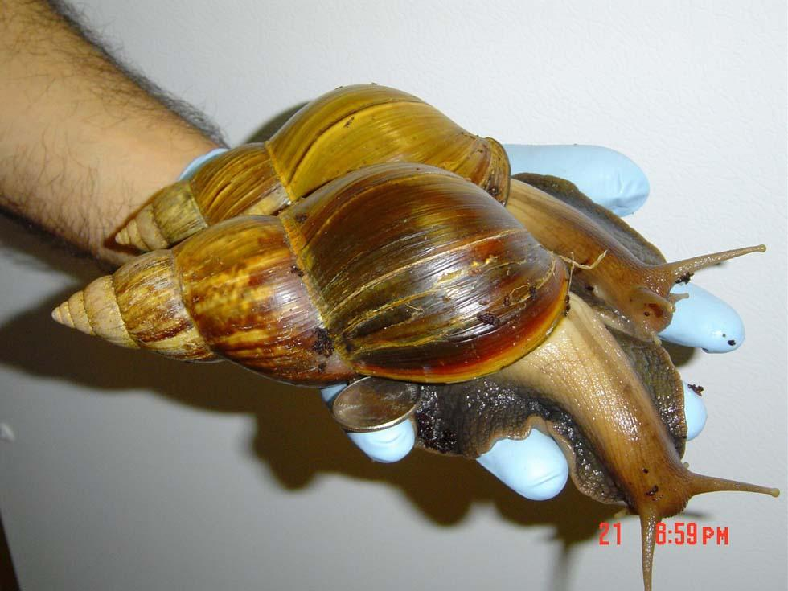
Snail

Slide 25
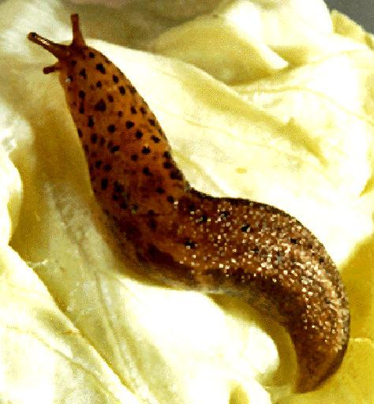
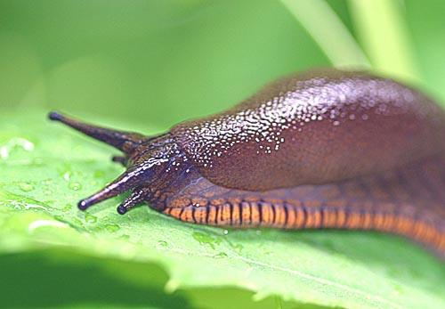
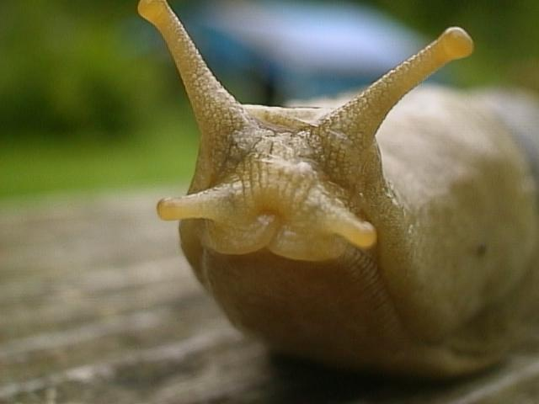
Slug

Slide 26
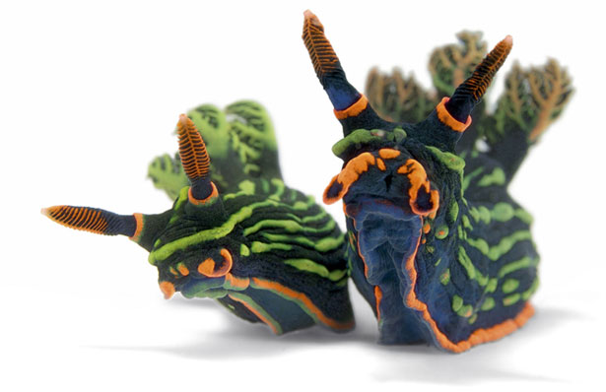
Nudibranchs (sea slugs)
Check out the nudibranch gallery at nationalgeographic

Slide 27
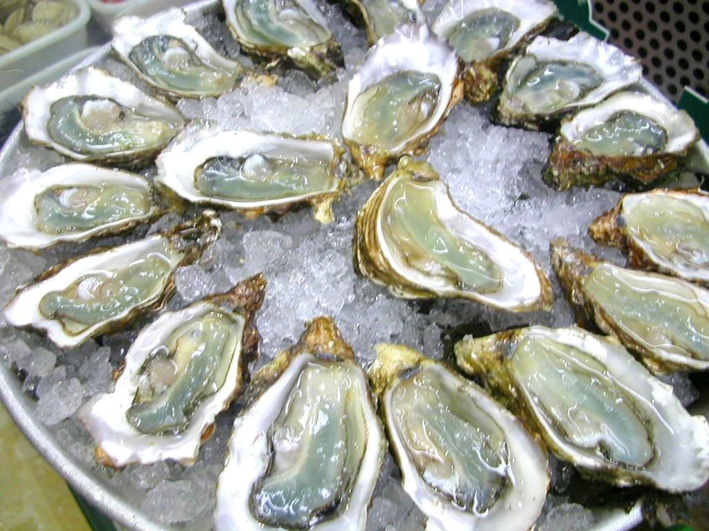
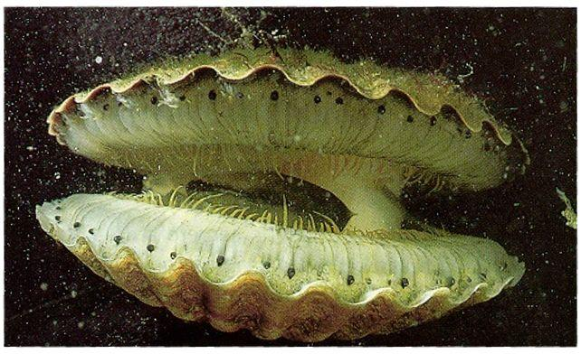
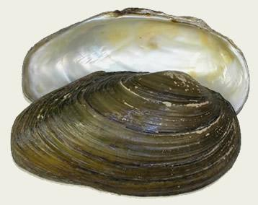
Bivalves (things with 2 shells)
Such as clams, scallops

Slide 28
Cephalopods
octopi, squids, cuttlefish, and nautilus
soft-bodied , head is attached to foot
foot is divided into tentacles with sucking disks
small internal shells or no shell at all

Slide 29
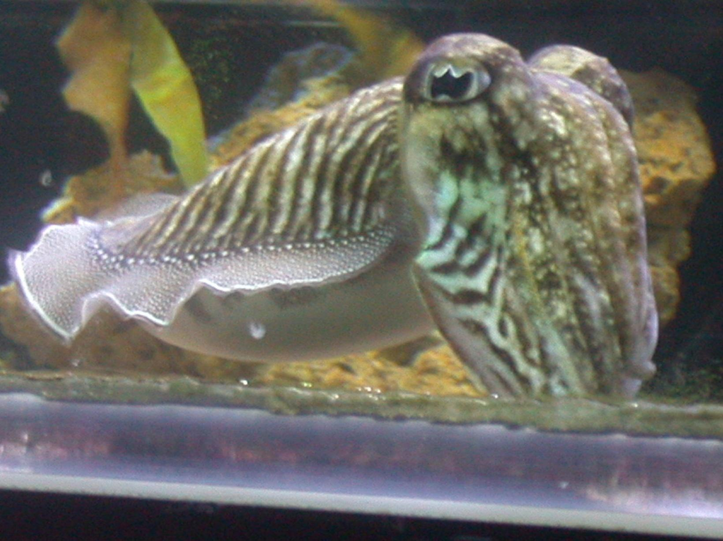
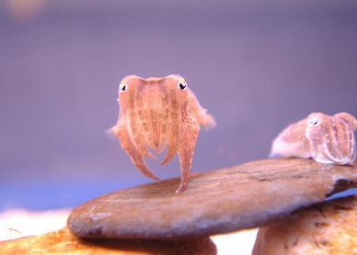
Cuttlefish (the chameleon of the sea)

Slide 30
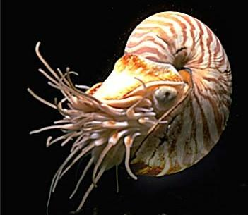
Nautilus is only cephalopod with shell
Squid have a modified shell called a pen
Well developed eyes
most complex of the mollusks

Slide 31
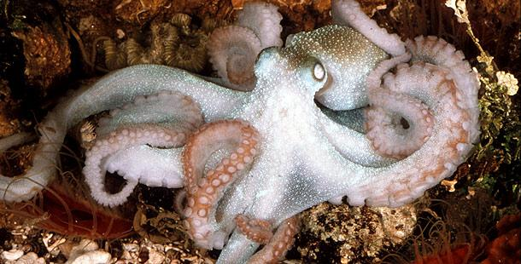
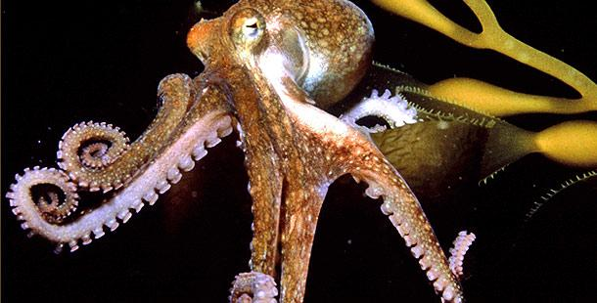
Octopus (creeps on tentacles)

Slide 32
Octopus Creepin’
https://www.youtube.com/watch?v=RojhxWUM3UE
https://www.youtube.com/watch?v=949eYdEz3Es

Slide 33
Octopus versus Shark
https://www.youtube.com/watch?v=p9A-oxUMAy8

Slide 34
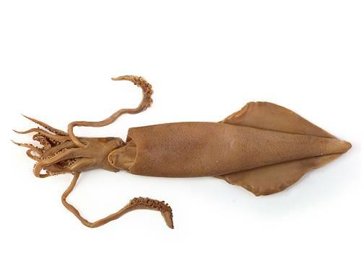
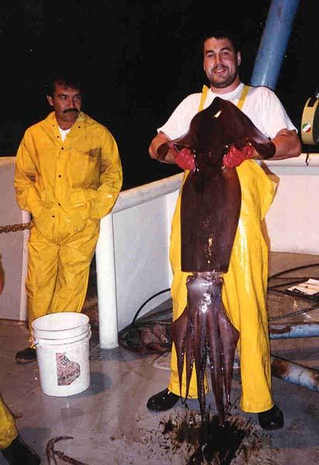
Squid

Slide 35
Btw…
Squid vs. OctopusBoth squid and octopus are aquatic animals with eight long arms. In addition to their eight arms, squid also have two long tentacles. They also have two fins on their head, unlike the octopus. Whereas an octopus has no hard shell or bone in its body, squid have a stiff backbone-like structure called a pen.
A squid is any of a variety of cephalopod with a long, soft, thin body and 10 arms (eight shorter arms and two long tentacles) and two fins on its head. Squid vary in size from very small to over 65 feet in length. They prey upon fish and crustaceans. Some squid have the ability to emit an inky cloud as a defense mechanism. Their tentacles may have hooks, suckers, or sucker rings. They live in the open ocean.
An octopus is any of a variety of cephalopod with a round head, soft body and 8 strong tentacles, each with two rows of suckers. Octopi range from 1 cm to over 5 meters in length. They live on the sea floor and obtain food by piercing it and injecting it with venom.
https://www.youtube.com/watch?v=SXgKb8GUjoM

